Slide 1


Presentation Skills
Using TED Talks to Teach Presentation Skills

Slide 2
Why Teach
Presentation Skills?
Group Projects, Business Projects, Weddings, Parties, etc.
CCSS.ELA-Literacy.SL.9-10.4 Present information, findings, and supporting evidence clearly, concisely, and logically such that listeners can follow the line of reasoning and the organization, development, substance, and style are appropriate to purpose, audience, and task.
CCSS.ELA-Literacy.SL.9-10.5 Make strategic use of digital media (e.g., textual, graphical, audio, visual, and interactive elements) in presentations to enhance understanding of findings, reasoning, and evidence and to add interest.

Slide 3
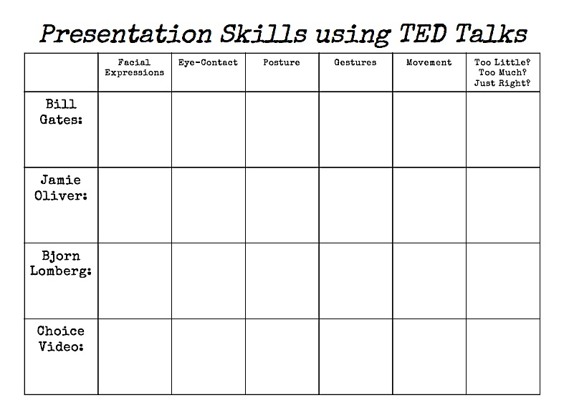

Slide 4
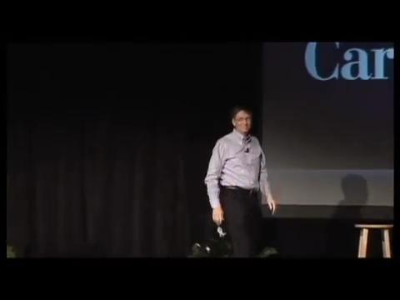

Slide 5
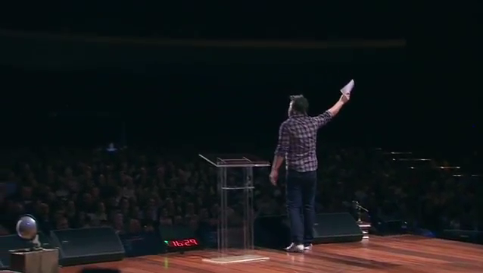

Slide 6



Slide 7
Your Assignment
Find a video on TED that you are interested in and watch it and score it.
Write a 1 minute speech
  You will be assigned TOO MUCH, TOO LITTLE, or JUST RIGHT
  Topics will be
    Your Favorite Band
    Your Favorite Movie
    Your Favorite Sport
    Why You Love (or Hate) PB & J Sandwiches
    Why You Love (or Hate) Homework

Slide 8
Public Speaking Tips
Know your material – Know more than what you plan on saying
Know your audience – Greet some people as they enter. Its easier to talk to friends than strangers
Know the room – Arrive early to get familiar with the layout and the setup
Relax! – Begin by addressing the audience. Take a deep breath before you start.
Visualize… yourself giving the speech ahead of time and killin’ it.
Don’t apologize… for any nervousness or problem.
Relax! – It’s just a speech…you’ll survive.

Slide 9
Tech Tips That Made This Presentation Better
Dafont.com – Download thousands of cool fonts.
YouTube Downloader
Don’t rely on Wi-Fi…yet!
Creativity – Don’t lose it!
It’s Free!
Chrome Extension

Slide 10

Tech Tips That Made This Presentation Better
Dafont.com – Download thousands of cool fonts.
YouTube Downloader – Don’t rely on Wi-Fi…yet!
Creativity – Don’t lose it!

Slide 11
Tech Tips That Made This Presentation Better
Dafont.com – Download thousands of cool fonts.
YouTube Downloader
Don’t rely on Wi-Fi…yet!
Creativity – Don’t lose it!
It’s Free!
Chrome Extension

