Slide 1

Not on Twitter?
It’s time…Let’s get connected! Right now!
Get the Twitter app
Sign up (short name, picture, bio)
Send out a tweet using the hashtag #ehsteachers about the best thing you’ve learned or done today. (140 character max)

Slide 2

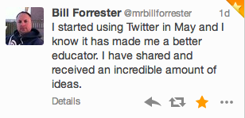
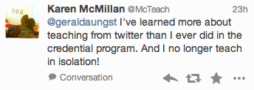

Twitter can be the best professional development you will ever attend…and the best part is that you can do it in your underwear. #pdinpjs
Agenda
Using Twitter without tweeting- lurking (It’s ok!)
Understanding #hashtags and Twitter chats
Tweeting – it’s easier than you think!

Slide 3
What I have learned from Twitter
I have discovered so many new and exciting things in the world of education. This is just a list of topics, strategies, etc. that I have discovered or explored via Twitter…
20% Time/Genius Hour
Self-Paced Learning
Project-Based Learning
Benefits of Blogging
Self-Reflection
Mastery Based Learning
Technology – 1:1, iPad, Chromebooks
Twitter Chats
Lesson Ideas
Resources
Classroom Management Ideas
    EdCamps
    QR Codes

Slide 4
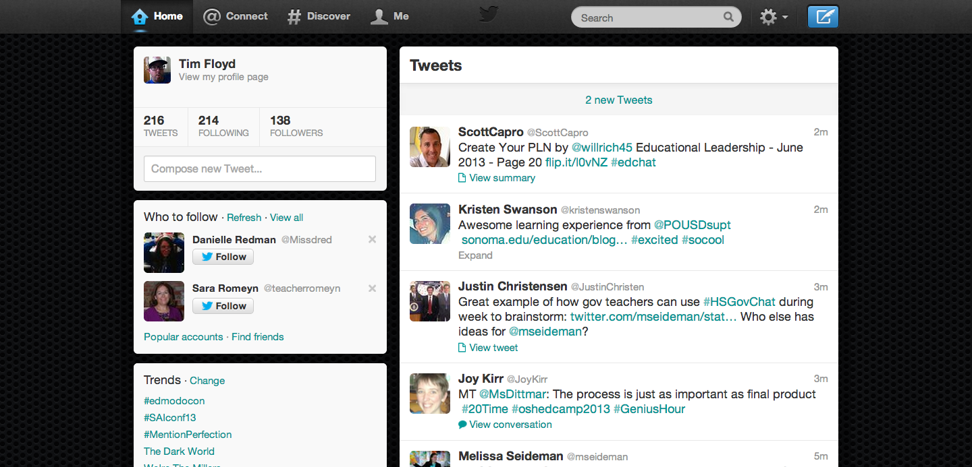
Using Twitter without tweeting Start Lurking!
Set up an account (avoid personal accounts)
Just search using the Twitter search bar (#s)

Slide 5
Understanding #Hashtags
Hashtags (#) are the key to Twitter
Knowing the right hashtags will help you find the good stuff on Twitter
Some key ones - #edchat #sschat #engchat #mathchat #scichat, #edleadchat #spedchat #tlap #caedchat, #1st5days…#ehsteachers
Notice the word chat…Twitter chats are confusing and fast, but very valuable.

Slide 6
Tweeting… it’s easier than you think!
Scary at first
You all have something to contribute and can be helpful to someone else, even if you don’t think so.
So much of our profession is based on collaboration and sharing (stealing). Share what you do or what you find. It makes us all better.

Slide 7
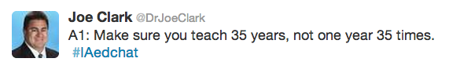
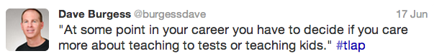
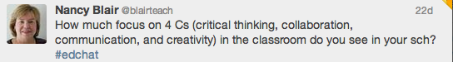

In addition to great resources, sometimes you just find things that make you think or get you reflecting on your own practices

Slide 8


Advanced
Use Evernote/Evernote Web Clipper to store everything you find.
Use Tweetdeck once you become more familiar with Twitter.

Slide 9
Now What?
Follow me @MrFloyd_edu and browse and follow people that I follow.
Tweet using #ehsteachers during breakouts
Refer to the hashtags and start lurking!
Email me if you have any questions.
Have a great year!!!

